Slide 1
Final Presentation Ticket Booking Application
Instuctor : Pasi Manninen
Gamage Danushka

Slide 2
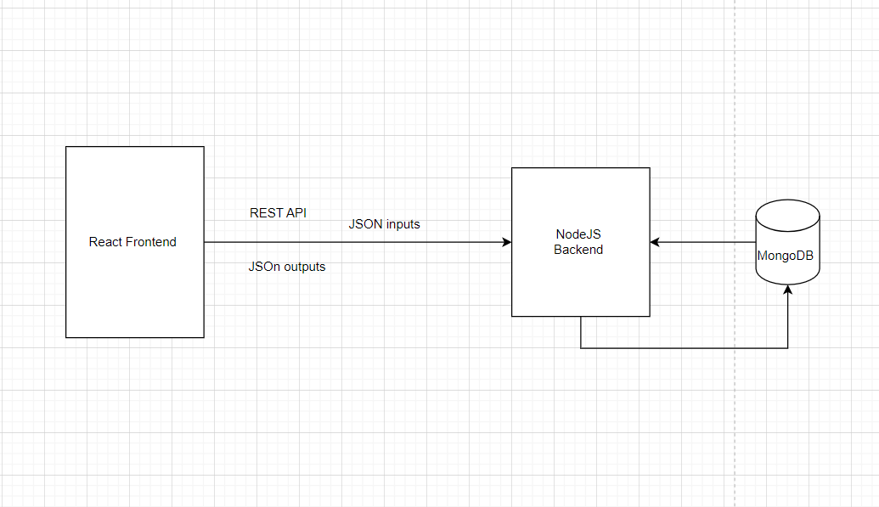
Project Architecture
Front End – ReactJS
Back End - NodeJS / MongoDB

Slide 3
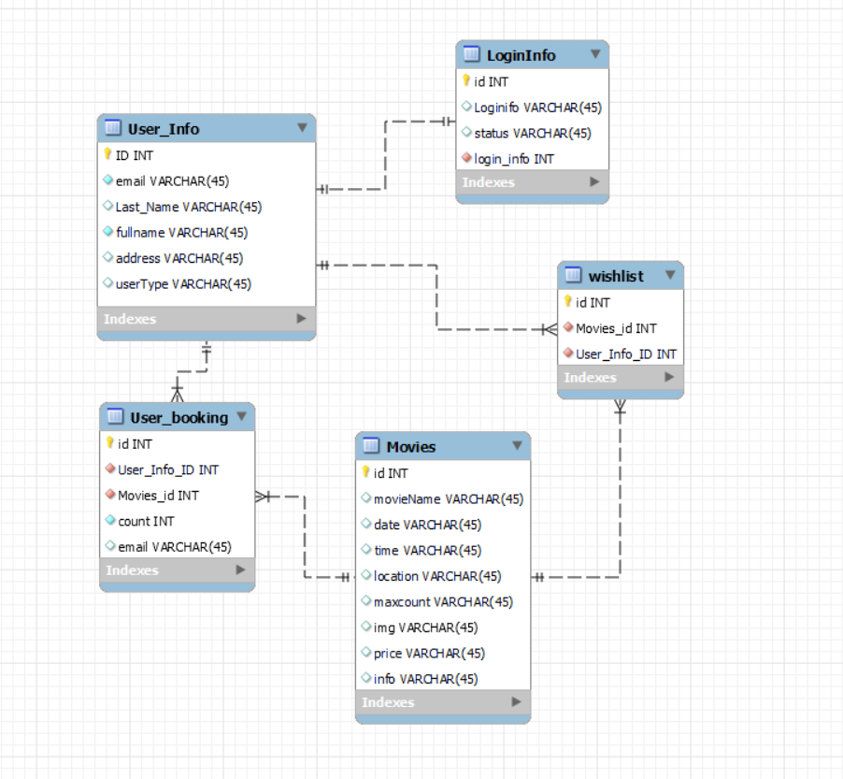
Back End Architecture
Used as NodeJs and MongoDB as backend
LoginInfo – Store the information related to logging information
Movies – Store the information related to ticket
User_Booking - Store the information related to user booked ticket information
User_info – Store the information related to user registration
WhishList – Store the information related to wish list (favorite)

Slide 4
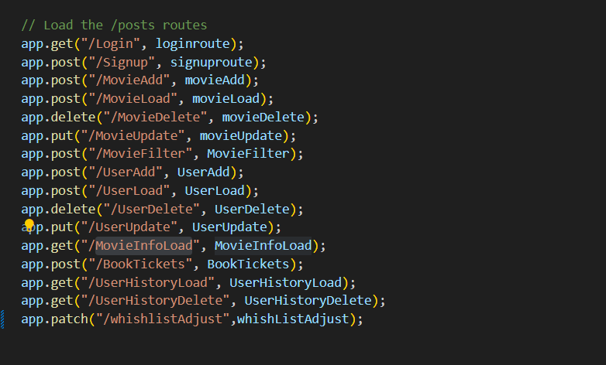
Rest End Points
Get Request (Login/MovieInfoLoad/UserHistoryLoad/UserHistoryDelete)
Post Request (SignUp/MovieAdd/..)
Delete Request (MovieDelete/UserDelete)
Put Request(MovieUpdate/UserUpdate)
Patch Request (wishlistAdjust )

Slide 5
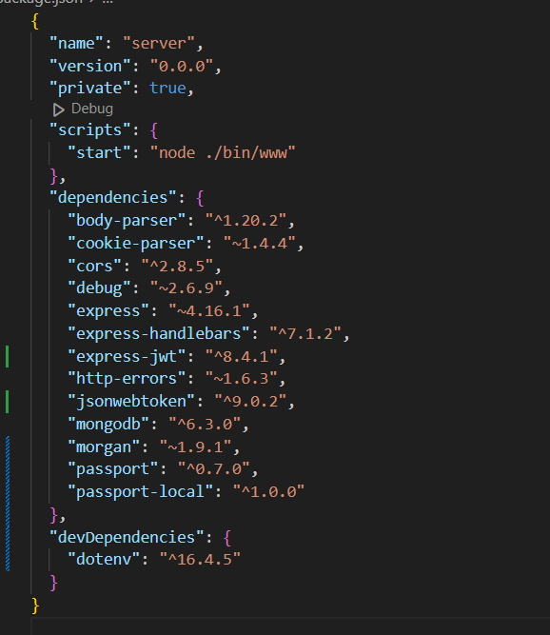
Used Npm/s

Slide 6
Front End Architecture
Used as ReactJs as frontend
Administrative privileges
User registration and login
Ticket listing with details
Ticket scheduling
Payment processing
Booking confirmation and ticket generation
Functional Requirements

Slide 7
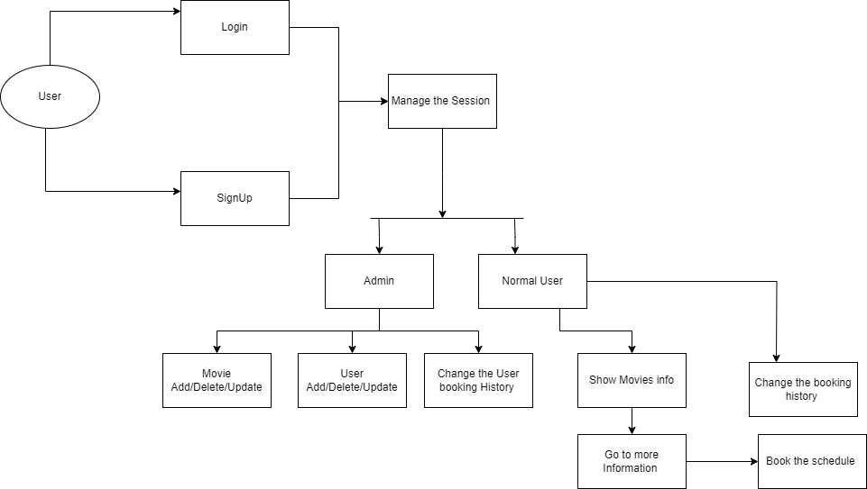

Slide 8
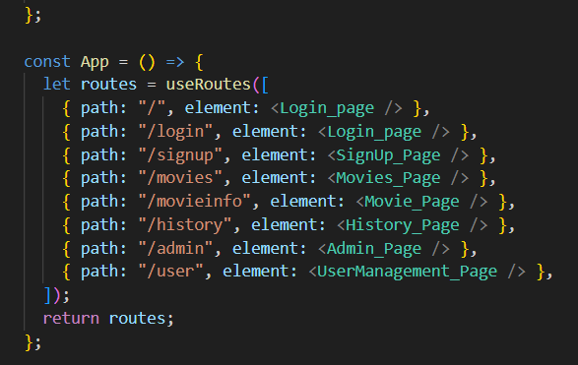
Route Configuration
Basically, routes are designed like this.

Slide 9
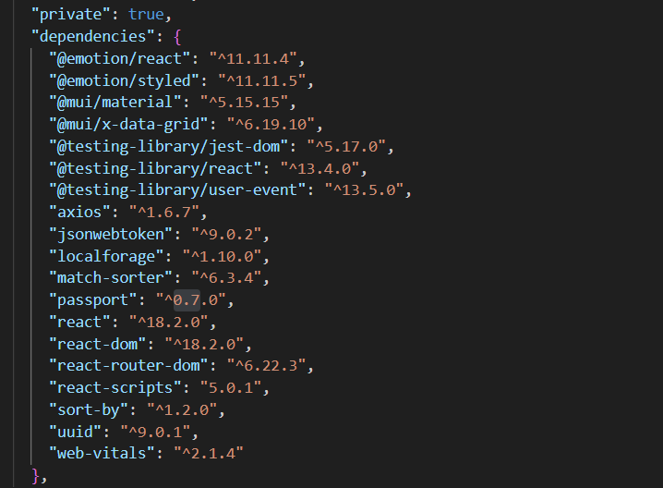
Used Npm/s

Slide 10
Thank you !

Slide 11
Functionality

Slide 12


